Slide 1
Windows app modernization with .NET Core 3.0, MSIX and WinUI
Matteo Pagani
Windows AppConsult Engineer
matteo.pagani@microsoft.com
@qmatteoq

Slide 2
Upgrading .NET Desktop Apps
What does ‘Upgrading’ even mean?

Slide 3
Why Upgrade Windows Desktop Apps?
Modern runtime, BCL and language features
New development is happening in .NET Core, including runtime optimizations and new language features
Easy access to platform and device APIs
Seamless application deployment, updates, and optimized for DevOps
Modern and accessible UI and input
E.g. Bluetooth, Camera, Location, Notifications, etc…
MSIX packaging supports automatic, incremental, behind-the-scenes application updates.
.NET Core supports CLI acquisition and updates for easy DevOps supports
Add in Windows 10 XAML where it makes sense for your applications with XAML Islands

Slide 4
Modern runtime, BCL and language features
Access to platform and device APIs
Modern and accessible UI and input
Seamless application deployment, updates, and optimized for DevOps
Notes:
Demo: PieSample

Slide 5

.NET Core 3. Why?
Faster
Side-by-Side installation
Better packaging options (MSIX)
Open Source
.NET Standard 2.1
New Features
Notes:
Open-Source
More performant
Great adoption and love
More frequent updates

Slide 6
.NET Schedule
July 2019
.NET Core 3.0
RC
Sept 2019
.NET Core 3.0
GA
Nov 2019
.NET Core 3.1
LTS
Nov 2020
.NET 5.0
GA
Nov 2021
.NET 6.0
LTS
Nov 2022
.NET 7.0
GA
Nov 2023
.NET 8.0
LTS
.NET Core 3.0 release in September
.NET Core 3.1 = Long Term Support (LTS)
.NET 5.0 release in November 2020
Major releases every year, LTS for even numbered releases
Predictable schedule, minor releases if needed

Slide 7
.NET Core 3.0
Demo

Slide 8
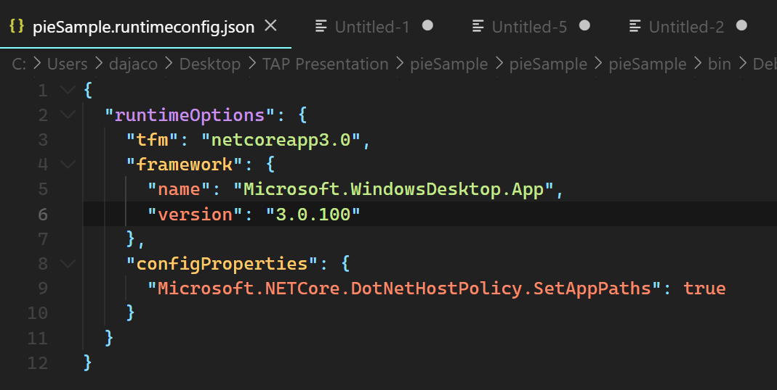
Demo Recap:
For testing purposes, you can run existing .NET Framework applications against the .NET Core Runtime

Slide 9
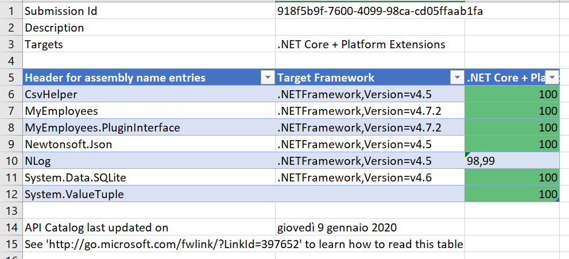
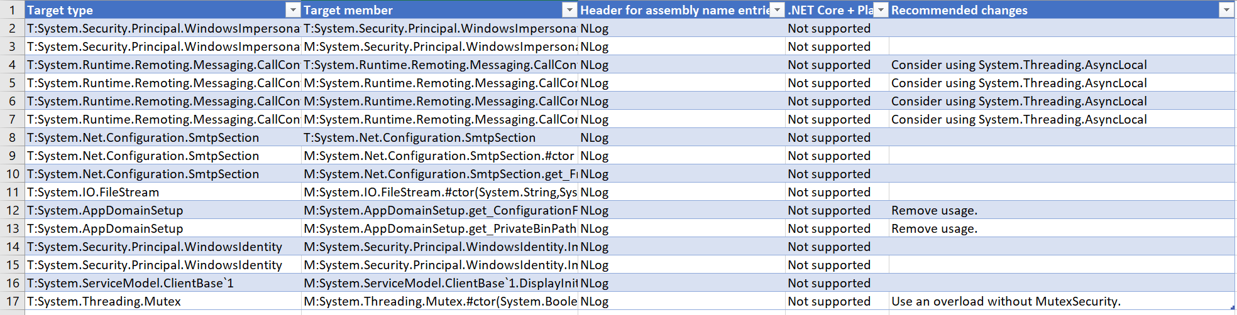
Is my application compatible with .NET Core 3?
Use Portability Analyzer
https://aka.ms/portabilityAnalyzer
.NET Blog: “Are your Windows Forms and WPF applications ready for .NET Core 3.0?”

Slide 10
Try to port with the tool
https://github.com/dotnet/try-convert
Will try to convert your old-style project file to the new SDK-style and retarget your executables to .NET Core 3
<Project Sdk="Microsoft.NET.Sdk.WindowsDesktop">
<PropertyGroup>
<OutputType>WinExe</OutputType>
<TargetFramework>netcoreapp3.1</TargetFramework>
<UseWPF>true</UseWPF>
</PropertyGroup>
<ItemGroup>
<PackageReference Include="Microsoft.Windows.SDK.Contracts" Version="10.0.18362.2005" />
</ItemGroup>
</Project>

Slide 11
Access to platform and device APIs
Modern runtime, BCL and language features
Modern and accessible UI and input
Seamless application deployment, updates, and optimized for DevOps

Slide 12
Evolving the Windows 10 platform
Microsoft is transforming how we deliver key Windows 10 platform technologies to you to be more agile, interoperable, and open.
Availability on deployed os version
Interop with existing code/libraries
Specific missing features
Desktop/Win32
Universal/WinRT

Slide 13
Evolving the Windows 10 platform
Microsoft is transforming how we deliver key Windows 10 platform technologies to you to be more agile, interoperable, and open.
Desktop/Win32
Pick the right blend for your app
Universal/WinRT

Slide 14
Access to Windows 10 APIs
Demo

Slide 15
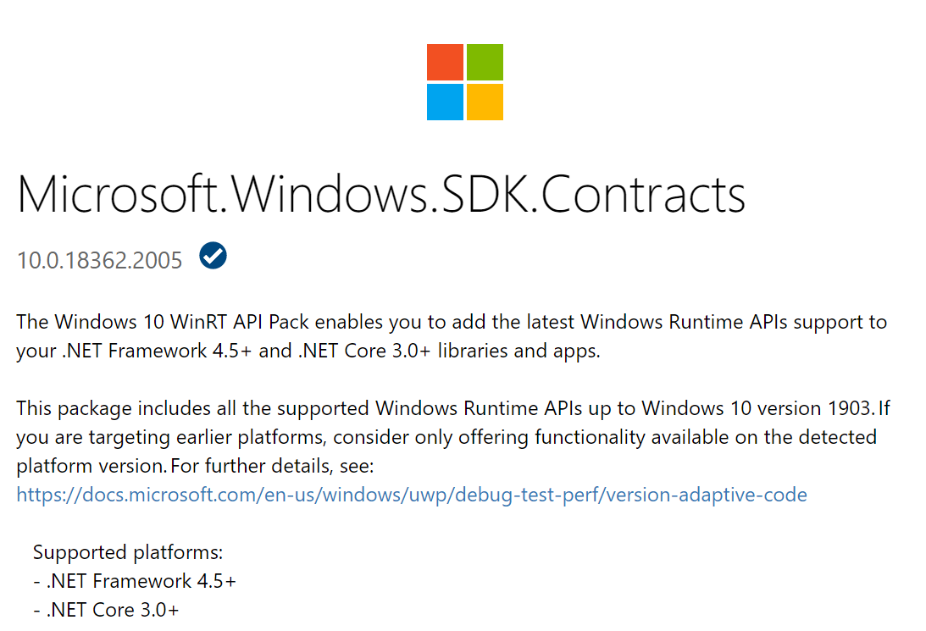
Demo Recap:
https://www.nuget.org/packages/Microsoft.Windows.SDK.Contracts

Slide 16
Modern and accessible UI and input
Modern runtime, BCL and language features
Access to platform and device APIs
Seamless application deployment, updates, and optimized for DevOps

Slide 17
Adding Windows 10 UI controls
Demo

Slide 18
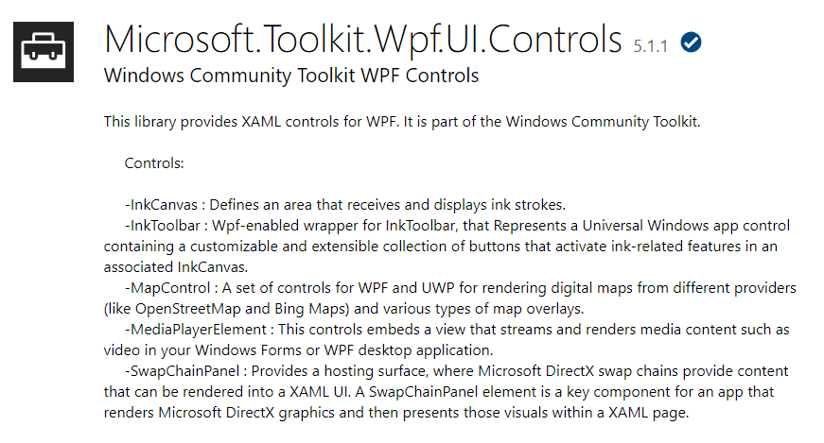
Demo Recap:
https://www.nuget.org/packages/Microsoft.Toolkit.Wpf.Ui.Controls

Slide 19


WinUI 2 & 3: From controls to full ux stack
WinUI 2
WinUI 3
UI Controls and Styles
UI Controls and Styles
Windows XAML
Windows XAML
Visual Layer
Visual Layer

Slide 20
WinUI 2 & 3: From controls to full ux stack
WinUI 2
WinUI 3
UI Controls and Styles
UI Controls and Styles
Windows XAML
Windows XAML
Visual Layer
Visual Layer

Slide 21
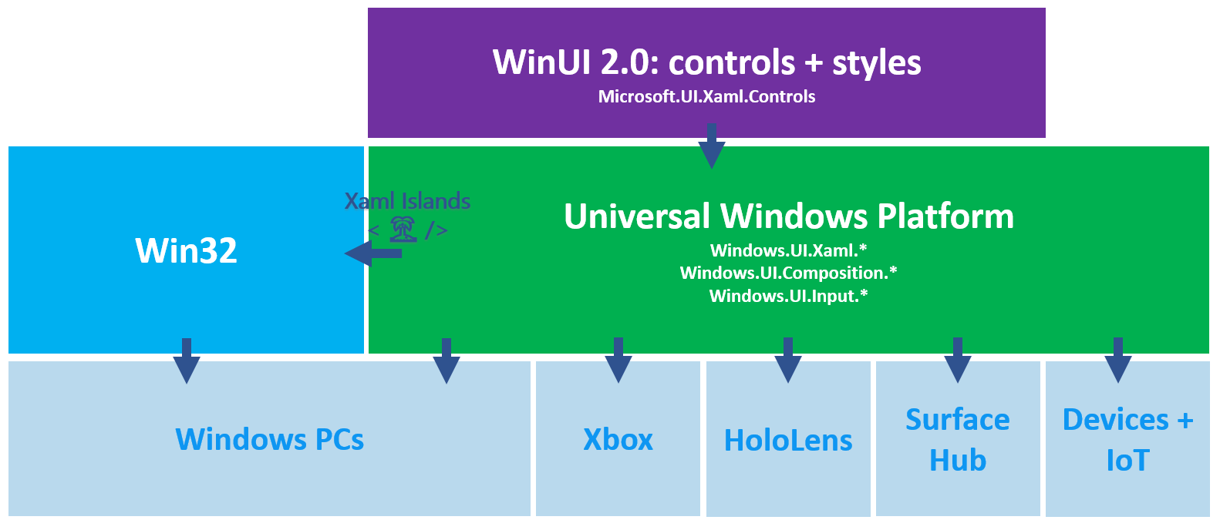

Slide 22
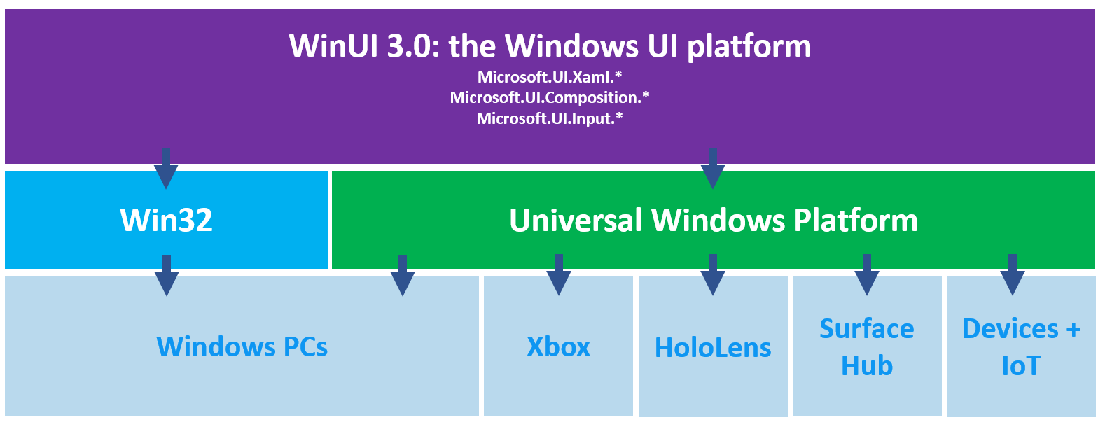

Slide 23
Seamless application deployment, updates, and optimized for DevOps
Modern runtime, BCL and language features
Access to platform and device APIs
Modern and accessible UI and input

Slide 24

Key Benefits of MSIX
Disk space
Network optimization using differential updates
Modern IT Virtuous Cycle
Enable OS, Apps & IT to update independently
Simpler packaging and deployment
Declarative install via Manifest file
Identity, formal versioning and device targeting
Optimized
Never Regret Installing an app
Predictable, safe, and reliable deployment
Trusted, clean install & uninstall – no Win ROT

Slide 25
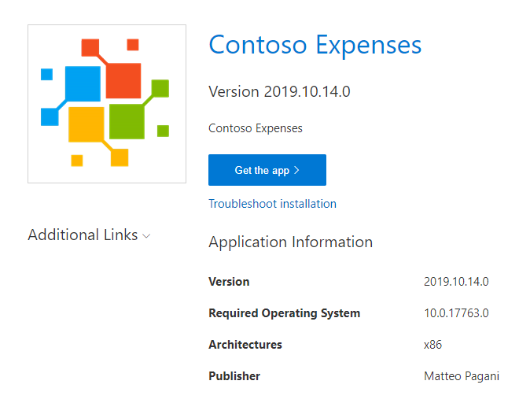
Automatic updates with the App Installer File
<?xml version="1.0" encoding="utf-8"?>
<AppInstaller
Uri="https://db-msixtest.azurewebsites.net/ContosoExpenses.Package.appinstaller"
Version="2019.10.14.0" xmlns="http://schemas.microsoft.com/appx/appinstaller/2018">
<MainBundle
Name="ContosoExpenses"
Version="2019.10.14.0"
Publisher="CN=Matteo Pagani, O=Matteo Pagani, L=Como, S=Como, C=IT"
Uri="https://db-msixtest.azurewebsites.net/ContosoExpenses.Package_2019.10.14.0_Test/ContosoExpenses.Package_2019.10.14.0_x86.msixbundle" />
<UpdateSettings>
<OnLaunch
HoursBetweenUpdateChecks="0"
ShowPrompt="true" />
</UpdateSettings>
</AppInstaller>
ms-appinstaller:?source=https://../../app.appinstaller

Slide 26
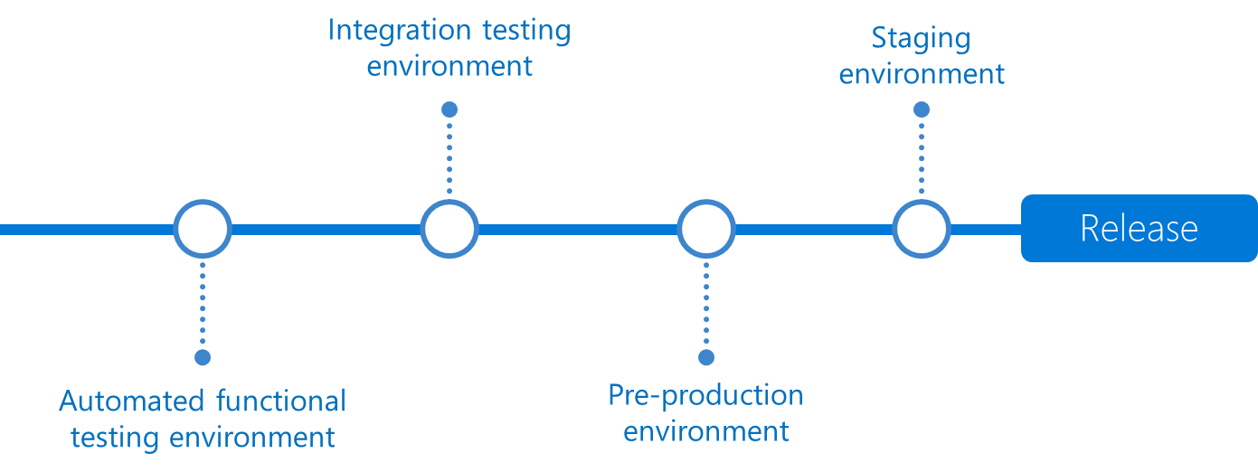




DevOps for Windows desktop apps
Continuous Deployment (CD)
By combining continuous integration and infrastructure as code (IaC), you’ll achieve identical deployments and the confidence to deploy to production at any time.
With continuous deployment, you can automate the entire process from code commit to production if your CI/CD tests are successful.
Release
Release
Release
Release
Release
Release

Slide 27
MSIX packaging
Demo

Slide 28
Upgrading Windows Desktop Apps – How?
Agility to innovate at a developer pace
Deploy .NET with your application for guaranteed compatibility and deployment flexibility
Modern runtime, BCL and language features
Upgrade your application from .NET Framework to .NET Core
Easy access to platform and device APIs
Seamless application deployment, updates, and optimized for DevOps
Modern and accessible UI and input
Add a reference to the Microsoft.Windows.SDK.Contracts NuGet package
Use the Windows Application Packaging Project to create an .MSIX package with .appinstaller technology
Use toolkit provided controls, or build your own and host them with the XAML Host Control
Use Azure DevOps + .NET Core SDK for easy client DevOps

Slide 29
Resources (and Q&A)
WinUI: aka.ms/winui
MSIX: aka.ms/msix
.NET Core 3: https://dotnet.microsoft.com/download/dotnet-core/3.0
.NET Conf content: https://www.dotnetconf.net/
WinForms designer: aka.ms/winforms-designer

Slide 30
Thanks!
Matteo Pagani
Windows AppConsult Engineer
matteo.pagani@microsoft.com
@qmatteoq

